Slide 1


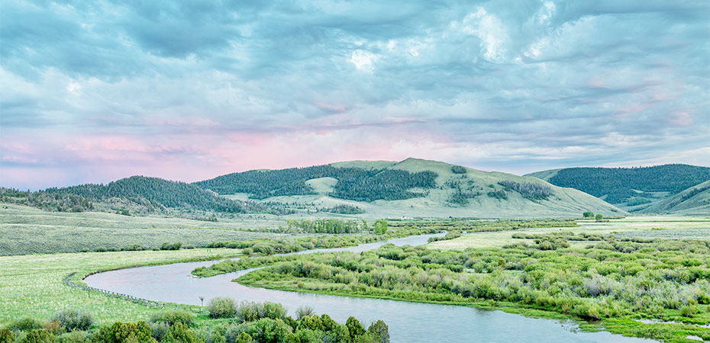


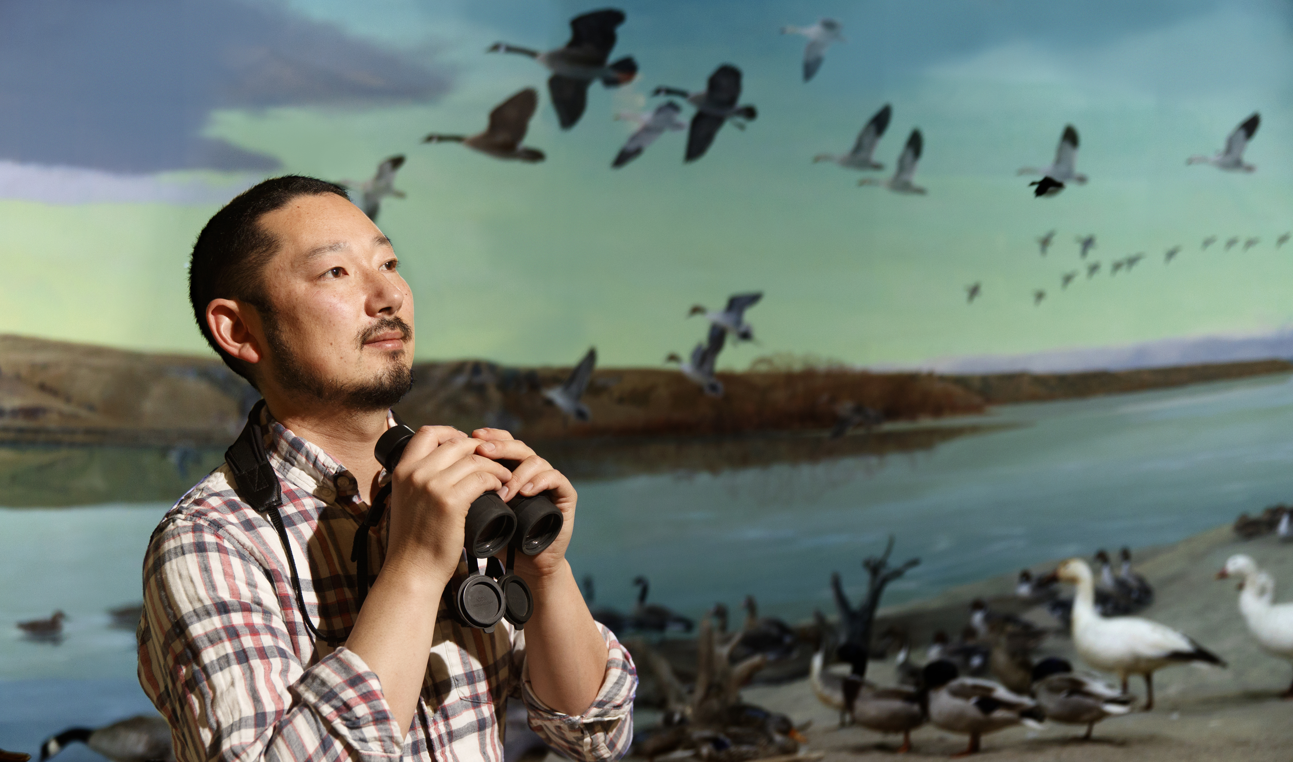

That’s fishy… unraveling Platte River fish resilience in response to drought events.
Jack Rodenburg
Advisor: Dr. Brigitte Tenhumberg Collaborators: Dr. Mark Pegg (SNR)
Dr. Dai Shizuka, Dr. Kate Lyons

Slide 2
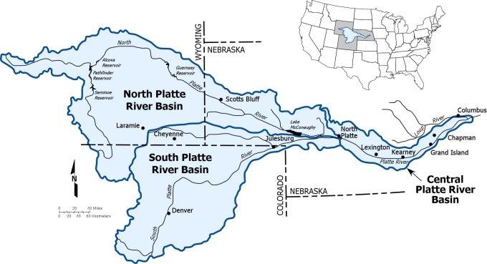
Introduction
Freshwater ecosystems are biodiversity hotspots
Increasing human activity (recreational, industrial) puts these ecosystems at risk.

Slide 3
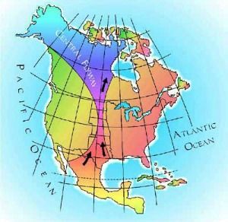
Introduction
The Platte River and Platte River basin are home to thousands of species, as well as providing a crucial stop migrating birds (Central Flyway)

Slide 4
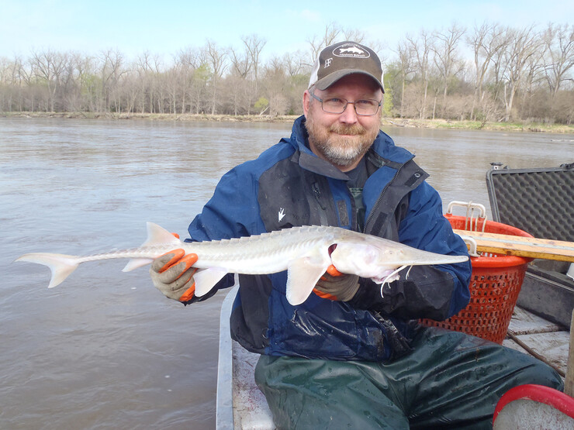
Data
Dr. Mark Pegg (SNR) and his lab have been collecting fish and amphibian data on the Platte River since 2006.
So far, not much analysis has been done, and relatively little is known about Platte River fish resilience.
Dr. Mark Pegg (SNR)
pallid sturgeon

Slide 5
Objectives
Compare diversity before and after 2012’s drought of the Platte River with various diversity indices (diversity, evenness, Shannon, Jaccard, Simpson).
Group and independently analyze drought response across various categorization methods:
Origin or Role: (native, invasive, recreational)
Functional groups (primary consumer, secondary consumer, predator).
Body size

Slide 6
Objectives (if time)
Select interesting sample species from each categorization. For example sturgeon (native), catfish (native, recreational), and carp (invasive).
Formulate matrix population models that fit the observed survival rates for 2012 drought response for the selected species.
Investigate the relationship between populations and diversity across river flow rate and depth

Slide 7
Methods
Calculate and plot various diversity indices across time for all species.
Calculate and compare resilience across multiple species categorization methods (origin/role, functional group, body size).
Analyze survival rates for sample species from various categories, (sturgeon - native, carp - invasive, catfish - native/recreational).
Create Leslie matrix population models for each sample species.
Compare various populations and diversity indices against river depth and flow rate.

Slide 8
References
Dudgeon, David, Angela H. Arthington, Mark O. Gessner, Zen-Ichiro Kawabata, Duncan J. Knowler, Christian Lévêque, Robert J. Naiman, et al. “Freshwater Biodiversity: Importance, Threats, Status and Conservation Challenges.” Biological Reviews 81, no. 02 (May 2006): 163. https://doi.org/10.1017/S1464793105006950.
Hamel, Martin Joseph. “DETERMINING SCAPHIRHYNCHUS STURGEON POPULATION DEMOGRAPHICS AND DYNAMICS: IMPLICATIONS FOR RANGE-WIDE MANAGEMENT, RECOVERY, AND CONSERVATION,” (2013, UNL PhD Thesis)
Goto, Daisuke, Martin J. Hamel, Mark A. Pegg, Jeremy J. Hammen, Matthew L. Rugg, and Valery E. Forbes. “Divergent Density Feedback Control of Migratory Predator Recovery Following Sex‐biased Perturbations.” Ecology and Evolution 10, no. 9 (May 2020): 3954–67. https://doi.org/10.1002/ece3.6153.
Blank, Aaron J. “CHANNEL CATFISH POPULATION DYNAMICS, ABUNDANCE ESTIMATES, AND SHORT-TERM TRENDS IN THE PLATTE RIVER, NEBRASKA,” (2012, UNL PhD Thesis)
Image References
https://www.nwf.org/Educational-Resources/Wildlife-Guide/Wild-Places/Platte-River
https://www.lowerplatte.org/who_we_are/about_lower_platte_river.html/title/central-flyway
https://nrt.unl.edu/platte-river-basin

